Slide 1
Using R to explore why ambulance waiting times have been getting worse?
NHS R lightning talk
Anne Alarilla
November 2022
Notes:
Hello everyone, thank you for having me. I’m here to briefly describe our learnings from using R to explore why have ambulance waiting times been getting worse.

Slide 2
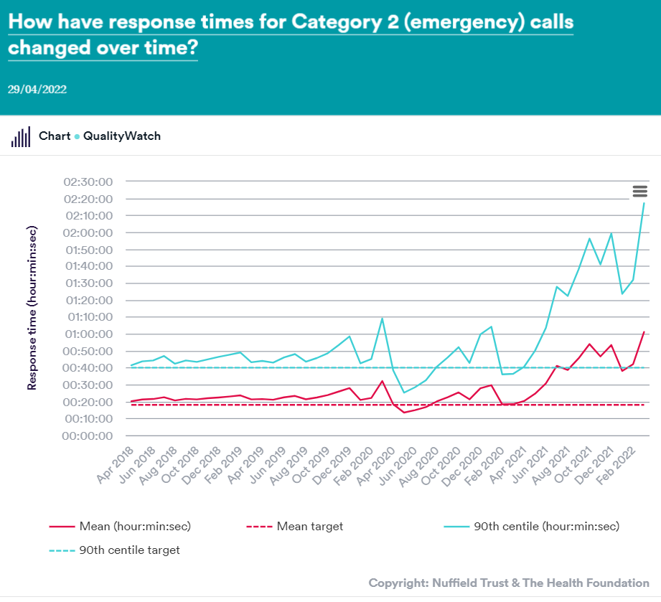
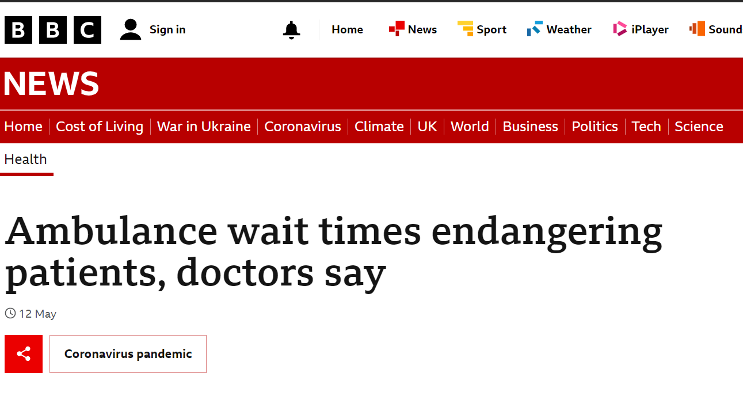

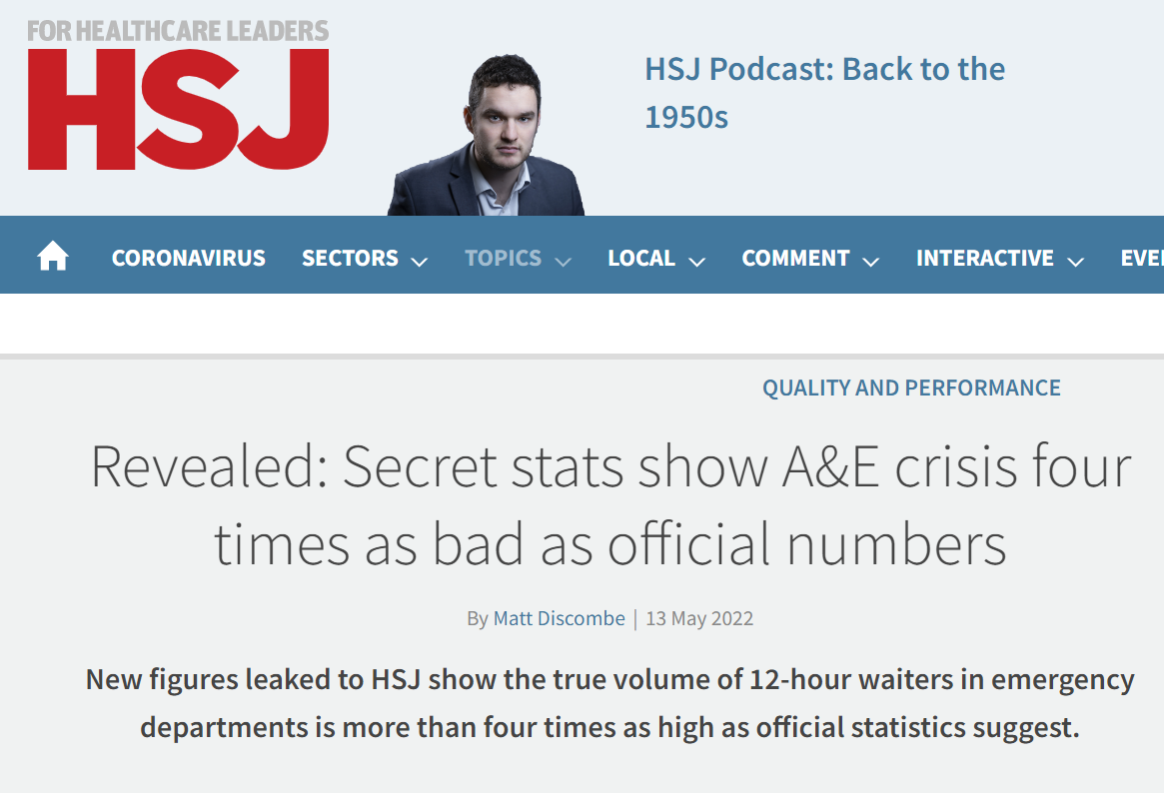
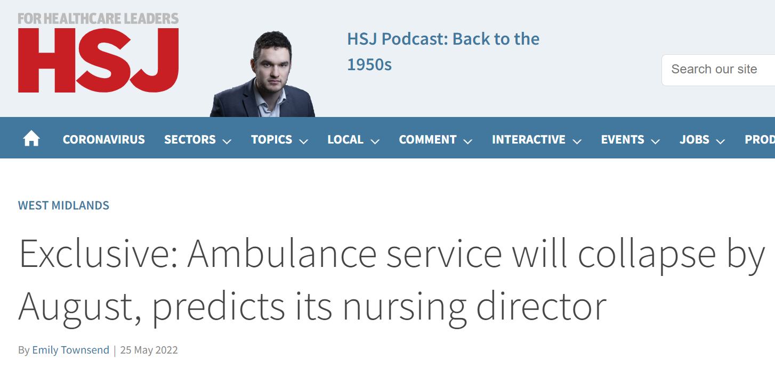
Context
Notes:
For a bit of context, earlier this year at the health foundation, we wanted to do more reactive analysis on topics that are currently relevant to health and social care. So back in May, when we started our scoping phase, NHS performance including ambulance waiting times and emergency care was under a lot of scrutiny from the media and beyond and now even more so. There were concerns for the impact the delays on patient safety and clinical outcomes and a lot of questions as to why this was happening and what can be done about it. So our task was to explore the current trends in ambulance waiting times and understand what could be contributing to them using open data in a timely manner.

Slide 3


Challenge?
A&E waiting times
NHS staff sickness absence rates
Critical care and general acute beds – urgent and emergency care daily situation reports
Urgent and emergency care daily situation reports
Ambulance quality indicators
Multiple data sources with different formats and various date ranges
Time constraints
Regular updates
Notes:
What’s the challenge for us?
So we needed to explore multiple data sets with various formats like csv, excel, xls, and with various date ranges, so some going as far back as 2009, but other only this past 2 years for example, with a quick turnaround and be prepared for regular updates.

Slide 4
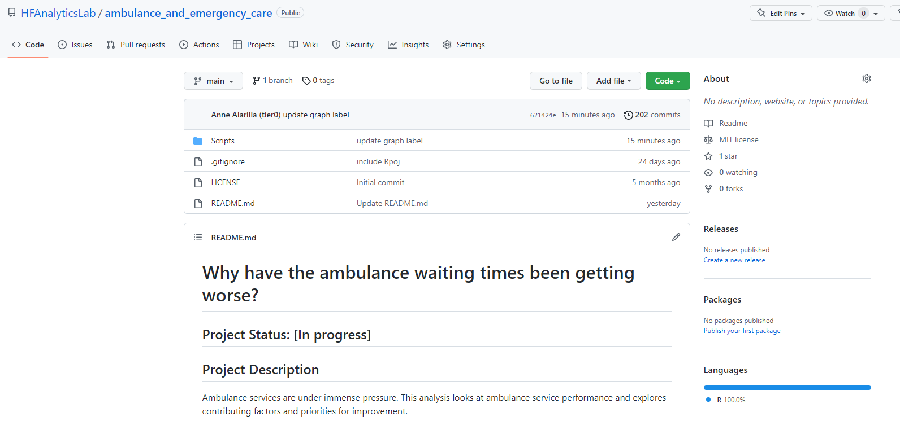

Solution?
Notes:
What’s the solution? Build a reproducible workflow in R and publish it on GitHub so anyone in my team and beyond our team can access and use it.

Slide 5

Learnings
Link download for easy download and updates
Functions for formatting issues
Standardise early and often
Have dates in long and short formats
Notes:
So I’m here to share some of learnings that made it easier to produce this reproducible workflow, and things that might be worth considering or using when thinking about preparing for your own. I should say that this is for using open data that doesn’t have an API.

Slide 6
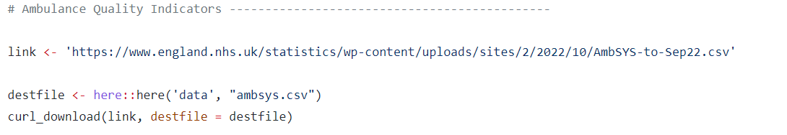

Easy download and updates?
Specify the url of the data set you want to download
Here::here( ) -> Specify where the file should be saved (should be a path with file name)
Curl::curl_download( ) -> Downloads the file based on the url of the file and saves it per the specified file path and name
Notes:
First thing I had to tackle was how do I download all these data sets, and how can I be prepared for regular updates and make sure that it’s easily updatable so even if it’s not me working on it, others in my team can.
Thanks to code that was already out there, I’ve adapted and used this particular sequence of code frequently.
First I get a link of my data set, as you can see in the blue.
Then I specify my file path of where I want the file to be saved and file name using the here function, as you can see in the red. The here function adapts to your local storage structure which means that whoever downloads the code, should in theory be able to run this script normally too.
Then I download and save the file based on the file path and name I’ve specified, using the curl download function as you can see in the yellow.
When we have updates, if it’s a full time series data, then we just update the link and our workflow can continue as it is, but if not, we just follow that method to download our new updates data and append that to our already existing time series.

Slide 7
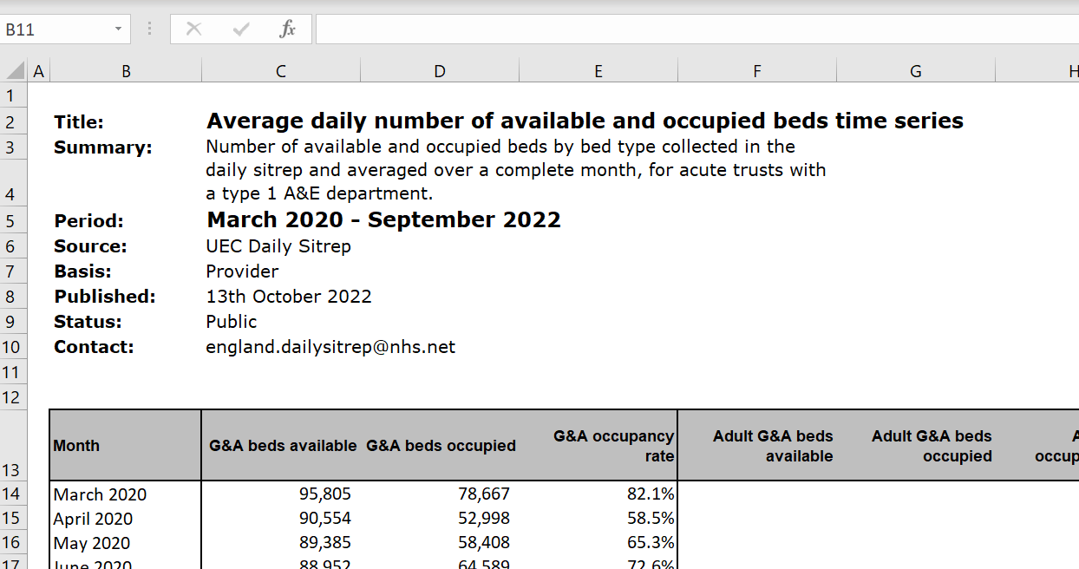
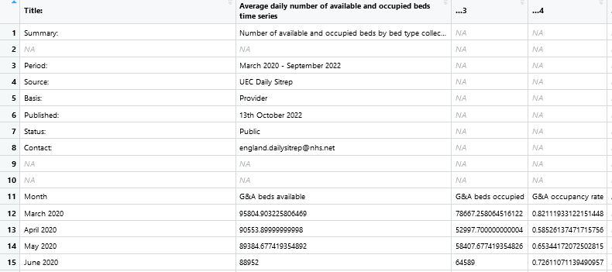
How to deal with formatted excel sheets?
Notes:
Next thing is, sometimes when using open data, it’s only available through formatted excel sheets. Like this one. So here you can see I’m trying to read in this data which is formatted to include information at the top of the excel sheet. When I read this into R, it reads like this. It keeps the information at the top which I just don’t need. Ideally, I want to read in from line 11, where it says month and the headings, but how do I get rid of this easily without hard coding.

Slide 8
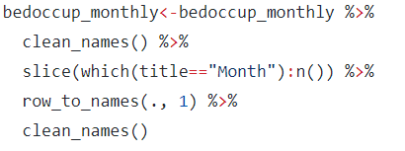
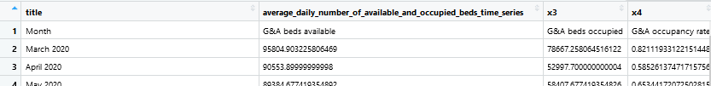
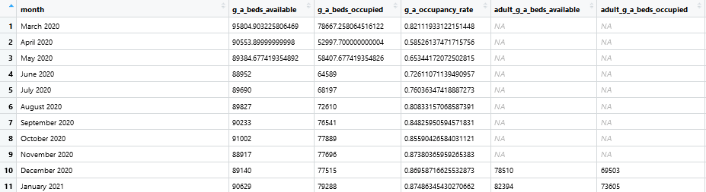
How to deal with formatted excel sheets?
Dplyr::slice( )->subset rows based on a specified location
which( )-> find the row number based on the argument specified
janitor::row_to_names () -> select the row that you want to be as column names
Notes:
Then you can use the function slice from dplyr to only keep a subset of rows based on the location you’ve specified, so here I’ve also used another function, which to specify the location that I want the subsetting to begin. So I’ve said to find the row number where it says month from the title column and subset from there until the end of my data frame.
My first row will now have month and then the next bit of code has the function row_to_names from janitor, which turns my first row into column names. So I have a data set that looks like this.

Slide 9

Standardising my work flow?
janitor::clean_names( ) -> Turns column names into “snake_case”
%notin%` <- Negate(`%in%`) : to filter observations that are not in the list
Notes:
The next tip is ways to standardise my workflow to make data manipulation and analysis easier.
Whenever I load any open data set in R, the first thing I do is clean the names, the clean the names function is under the janitor library, and all it does is it turns all your column names into snake cases, so turns into lowercase and adds underscore instead of spaces, making it consistent and easier to manipulate at later stages.
Then when dealing with multiple data sources, you also have to deal with various length of time series, so how do I ensure that I only keep the time range that are relevant. To do this, I negate the %in% operator, to filter out the time ranges that I don’t want.
This way it only retains the time points that I do want, including the latest data points. Negating is better than just specifying what to include because that way you won’t to keep changing the range to include the latest data.

Slide 10
How do I deal with dates?
as.Date( ) -> to specify dates but they can be different formats
Long format (most granular level)- for calculations and plotting
Shorter format (one above the most granular level)- for merging across different data sets / years
tsibble::scale_x_yearmonth()-> to easily set the breaks and how date is displayed
Notes:
Then final the last tip, is how do I deal with dates across multiple sources.
Dates are always tricky for me anyway, so this actually took me a while to figure out. As.Date function can be found in base R but what’s important to remember is that the format that you specify is key.
You need to tell R which is the year, which is the month, and which is the day and how this appears in your variable including whether it’s spaces or hyphens between them. I always google date formats.
I then tend to have a long format, which is the most granular date, and a short format which is one above the most granular format. So for example, here my long format is days, months and year and my short format is month and year.
I do this across all my data sets, this way I can refer back to the correct date with the long format which is useful for calculations and plotting but I can use the short format if want to merge the different data sets together.
The other thing that I find useful, is when have dealing with daily data usually for situation rep reports, this can be aggregated to weeks using date2ISOweek function. That way I can use the iso week to compare across different years.
Then finally, scale_x_yearmonth function from tsibble library makes it easier to format how dates are displayed in your plot. It makes it easier to stylized your plot, so here I’ve specified that I only want to display this in 6 months increments and be displayed as month and year.

Slide 11
Findings

Slide 12
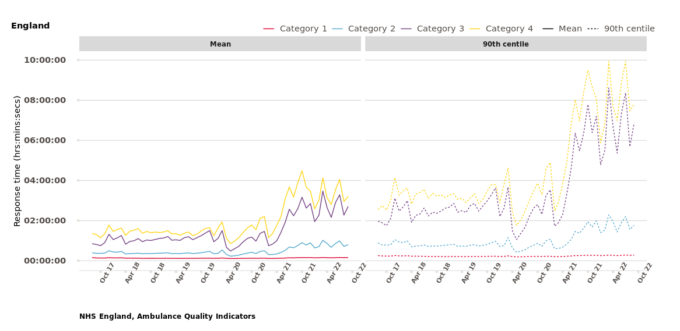
Response times are increasing
Cat | Description | Change 2018-2022
1 | A time critical, life threatening incident | 18%
2 | An emergency requiring rapid assessment/ intervention | 90%
3 | Urgent, non-life threatening | 116%
4 | Non-urgent requiring transportation | 118%
Notes:
We know that ambulance times are increasing, and this is happening across all categories that ambulance services respond to. So, these can range from life threatening incident, category 1 which requires the fastest response to non-urgent cases which are not as time sensitive and may require transportation. We see less of an increase in response times in categories that have a higher priorities, so here category 1 and 2.

Slide 13
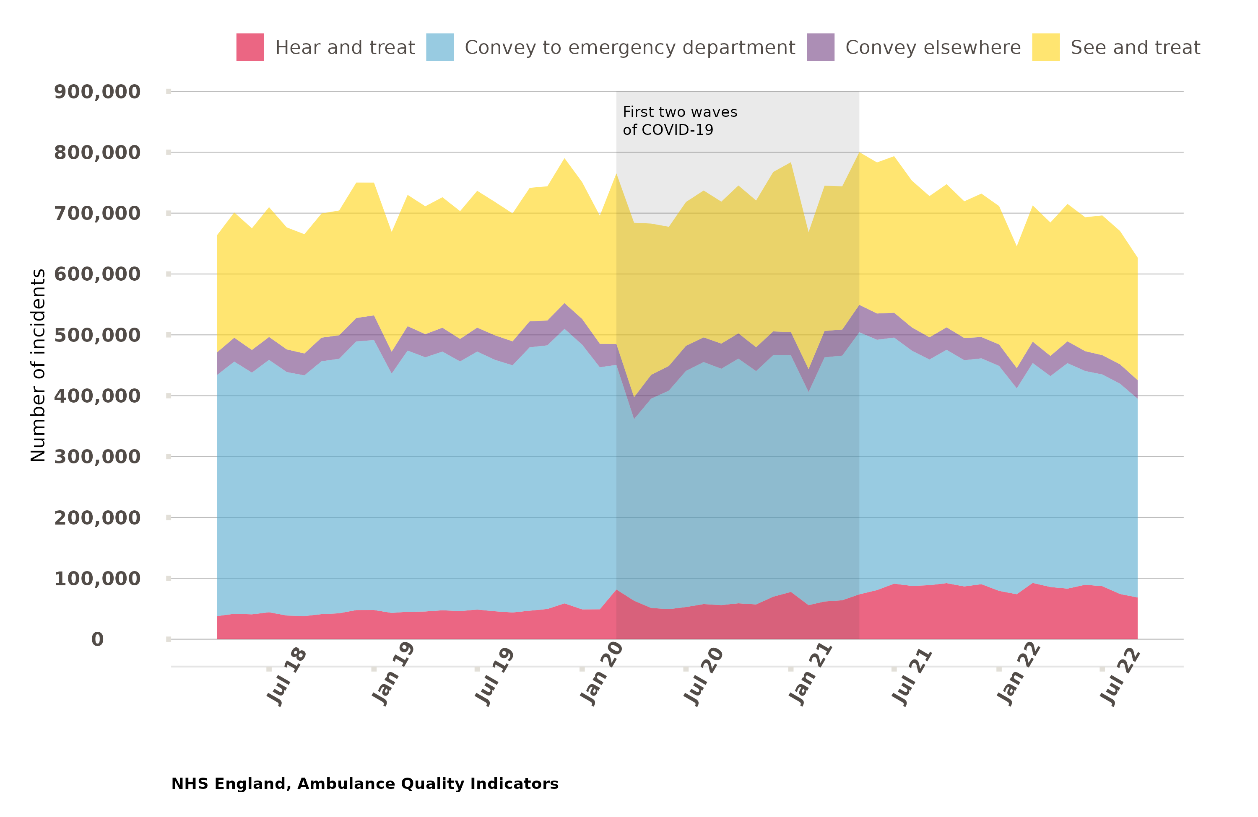
Demand for ambulances
Total volume of incidents similar in April 2018 and September 2022
Increase in number of incidents resolved over the phone between April 2018 September July 2022
Notes:
We also saw that the nature of demand for ambulances have stayed consistent, but the nature of these demands is changing. We are seeing more incidents resolved through telephone advice so that’s the area in red

Slide 14
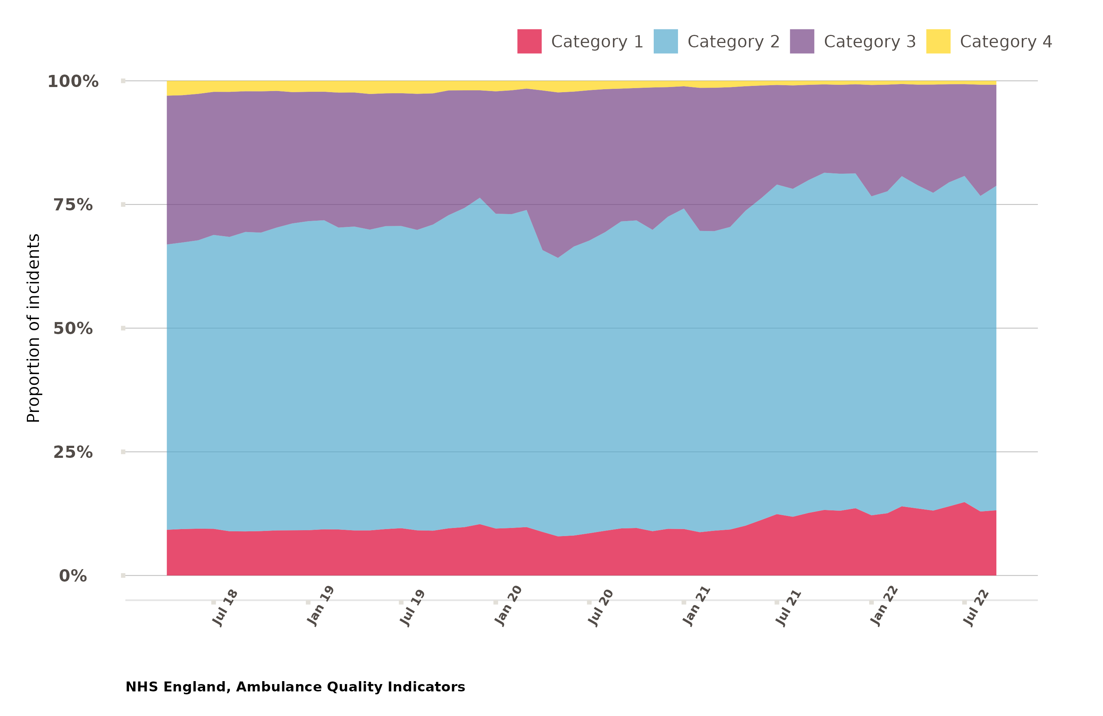
Demand for ambulances
Total volume of incidents similar in April 2018 and July 2022
Increase in number of incidents resolved over the phone between April 2018 and July 2022
Higher proportion of incidents in 2022 were life-threatening (category 1) or emergency (category 2)
Notes:
and among those incidents that require a face to face response we are seeing a higher proportion of life-threatening or emergency incidents which require the most resources.

Slide 15
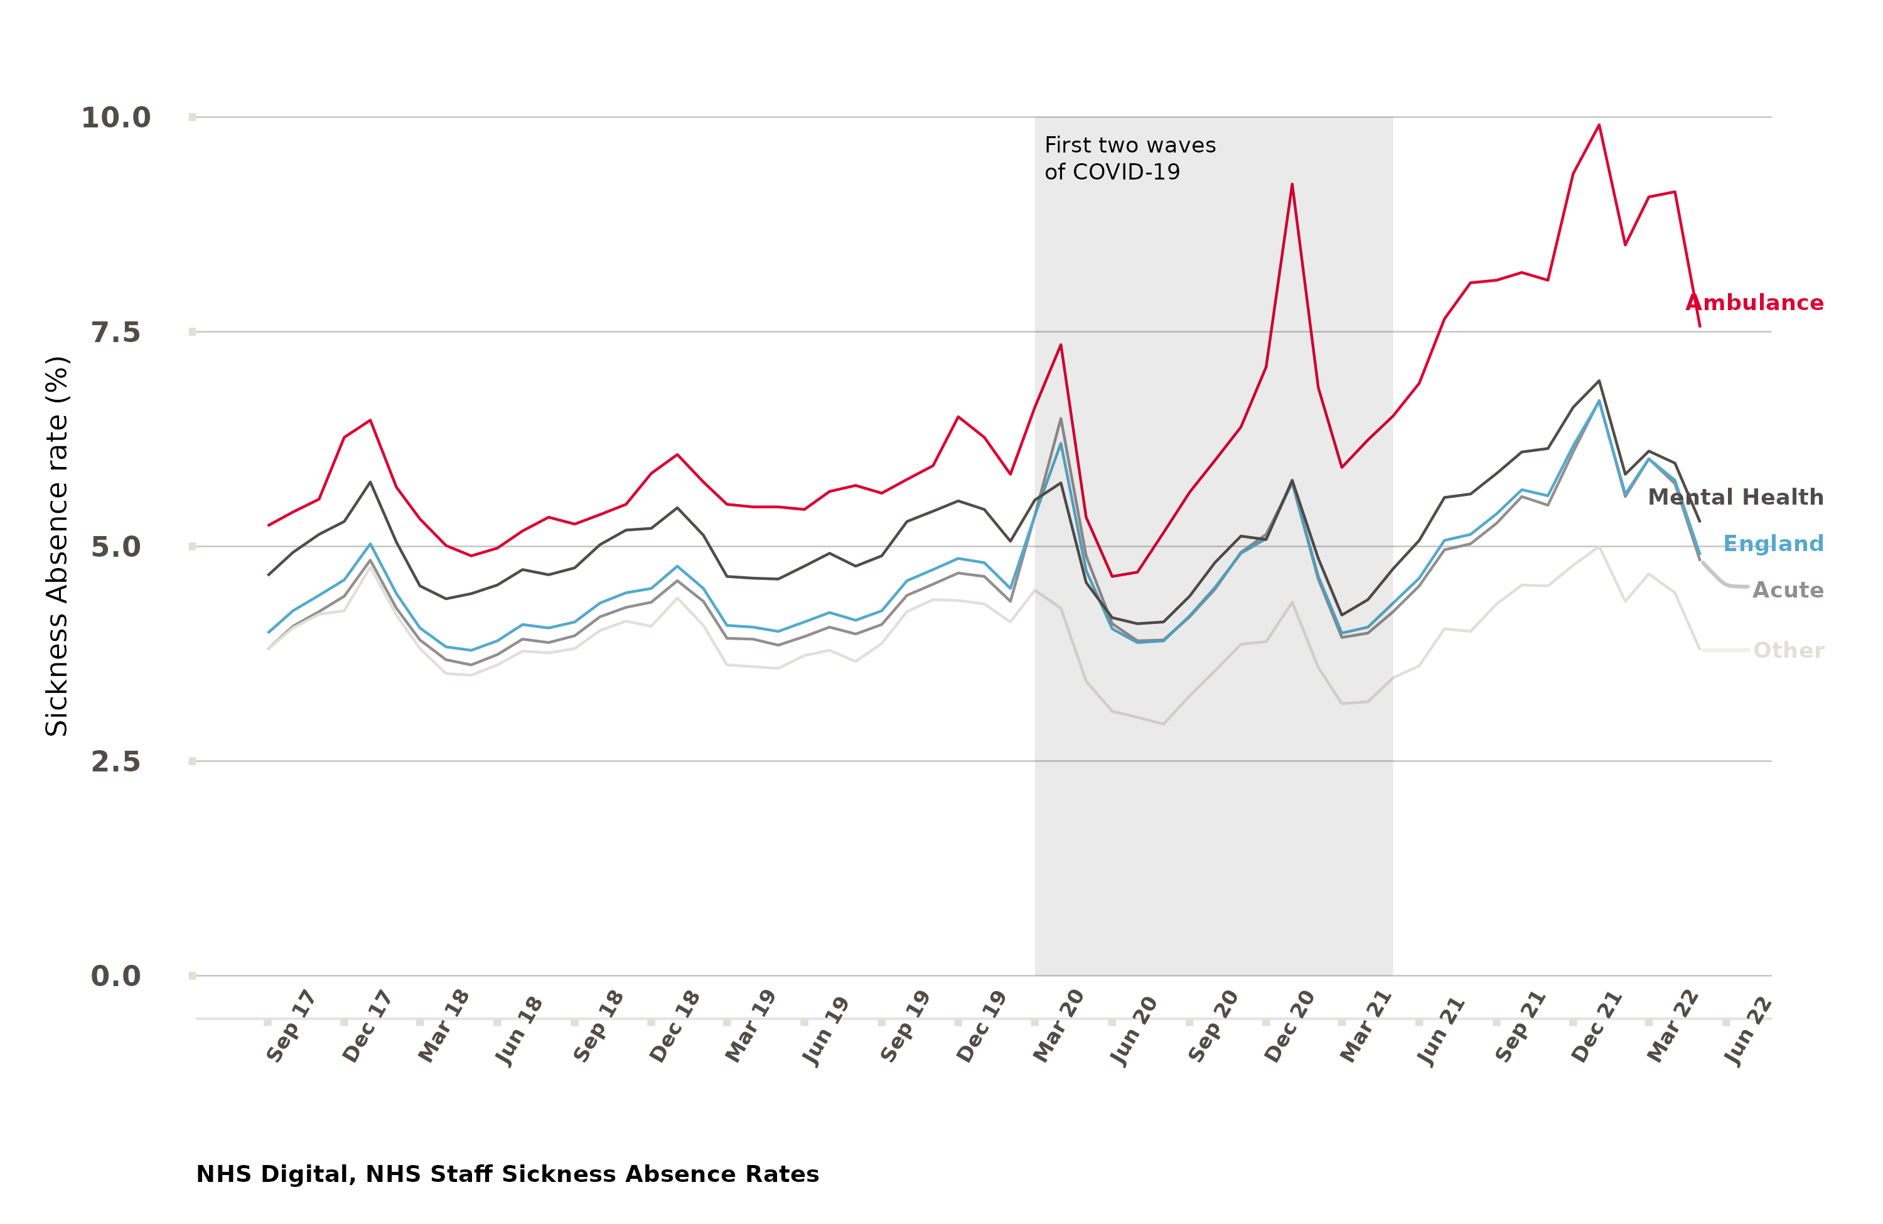
Ambulance service capacity
March 2019 – March 2021 saw increase in paramedic FTE
Though this wasn’t reflected in ambulance staff perceptions
Staff sickness absence rising
Notes:
The number of paramedics has increase but the ambulance sector is reporting the highest sickness absence rate of any occupation types commonly attributed to poor mental health.

Slide 16
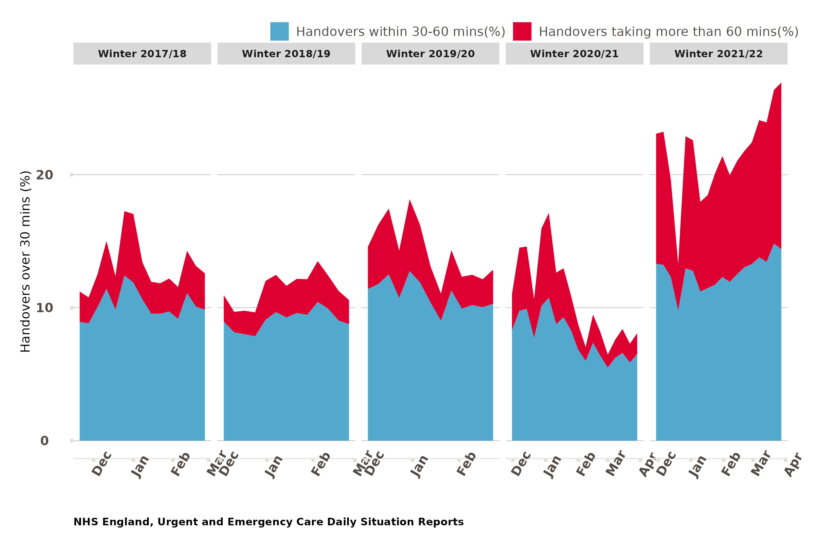
Ambulance service capacity
Increasing handover times from ambulance to A&E
Even a small increase in handover delays can lead to greater increases in response times
Notes:
And they are also spending longer waiting with patients outside of hospital. How the system is designed means that even a small increase in handover times, means a greater increase in response times. So handover delays are the main contributor to decline in ambulance performance.

Slide 17
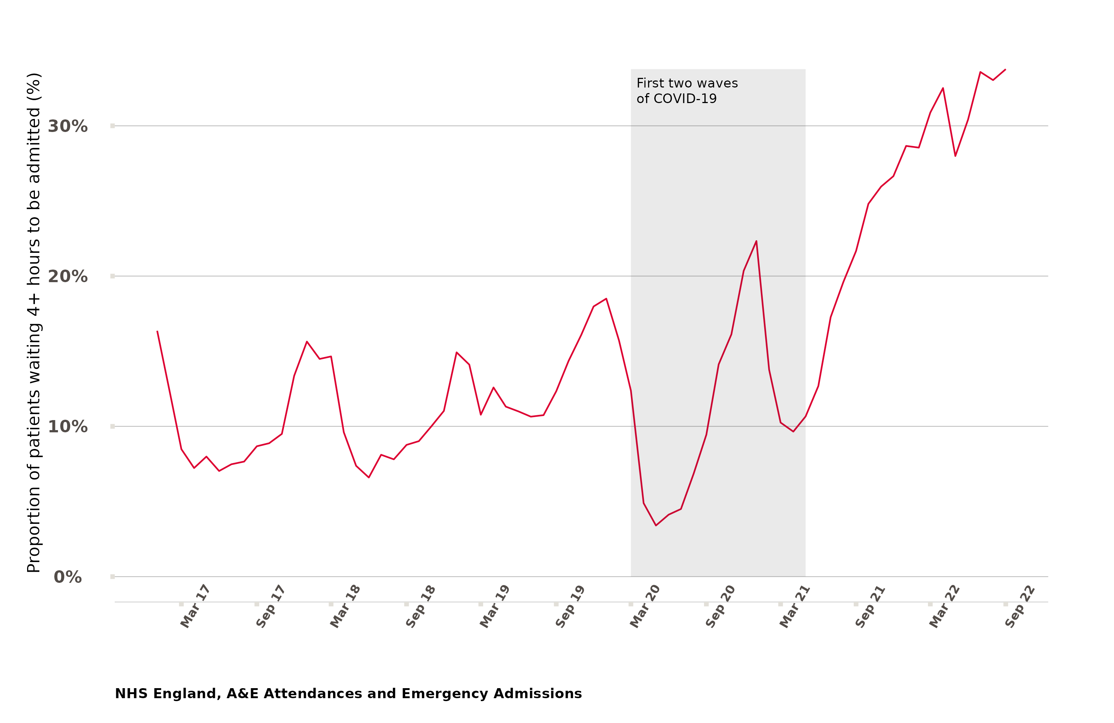
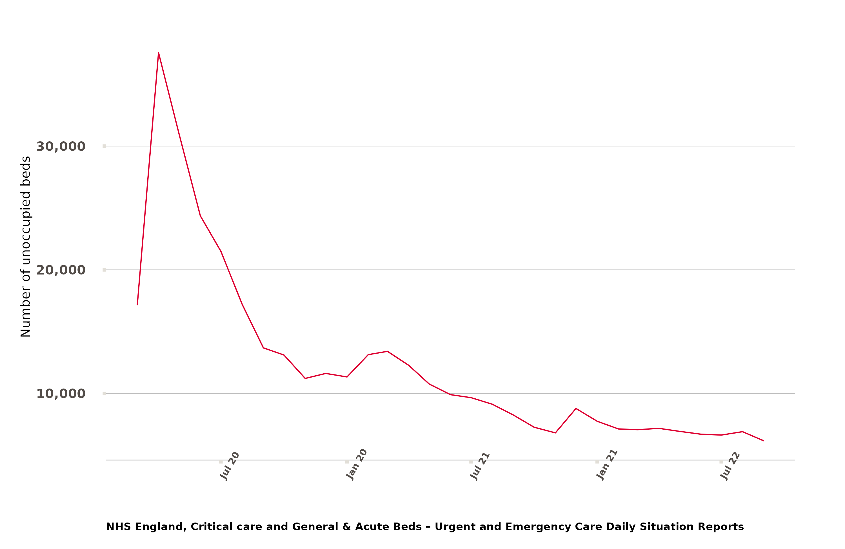
What’s needed to reduce ambulance response times?
1.Increase hospital bed capacity and improve patient flow through hospitals
Notes:
So how can we improve this?
To reduce handover delays, we need to increase hospital bed capacity and patient flow

Slide 18
What’s needed to reduce ambulance response times?
2. Expand and support the (ambulance) workforce
Staff vacancies and absence in other sectors (also rising since 2021) probably indirectly impact ambulance response times
Social care workforce
3. Reduce demand for ambulances by improving access to other services
eg Mental health conditions
Notes:
We also need to increase ambulance service capacity through increasing number staff and reducing sickness and absence rate and building on workforce beyond the immediate ambulance service, such as social care
Then finally, we need to reduce the demand for ambulance services by greater investment in community services

Slide 19


Link: https://www.health.org.uk/publications/long-reads/why-have-ambulance-waiting-times-been-getting-worse

Slide 20

@AlarillaAnne
Anne.Alarilla@health.org.uk
With thanks to: Members of North West Ambulance Trust, Yorkshire and Humber and Ambulance Trust and Association of Ambulance Chief Executives (AACE)
GitHub: https://github.com/HFAnalyticsLab/ambulance_and_emergency_care/

